Slide 1
Mathematicians of the Nineteenth Century
Journey Through Genius Pp 245

Slide 2
Mathematics through the centuries
As you may have noticed, each century has had a different emphases, “their own different directions to the flow of mathematical thought” Eighteenth century was the “century of Euler” The nineteenth century, by contrast, had no one mathematician, but a plethora of mathematicians pushing frontiers It was a century of abstraction, generalization, deep analysis of logical foundation of mathematics 19th century mathematics seemed to drift away from the constraints of the real world, bringing us things such as non-Euclidean geometry When Eugenio Beltrami discovered that non-Euclidean geometry was as logically consistent as Euclid’s own, a bridge was crossed.

Slide 3
Which geometry was used to describe the natural world was not as relevant as the logic that defined such geometry.
“To a mathematician engrossed in the strange and beautiful theorems of non-Euclidean geometry, the beauty was enough.”

Slide 4
“...historians may look at today’s mathematics as having ventured too far from its ties to the real world. But it is inconceivable that mathematics will ever assume a role entirely subservient to the needs of the other sciences. Mathematical freedom will forever be the legacy of the nineteenth century.”

Slide 5
Calculus and the infinitely small, under the microscope
Calculus foundations were pinned down by Newton and Leibniz in the seventeenth century and exploited heavily in the eighteenth century by Euler, yet these greats had not paid adequate attention to the underpinnings of calculus. The problem lied in the use of “infinitely large” and “infinitely small” One of the key ideas of calculus lies within the “limit” , differential and integral calculus, series convergence and continuity of functions rest upon this notion To talk about this term “limit” and try and make this idea logically precise, difficulties instantly arise

Slide 6
More on the Limit
Newton tried to examine what happens when a ratio of quantities both emerge zero simultaneously, he used the term “ultimate ratio” to describe this phenomenon, although he was referring to the limit
Leibniz also discussed the limit as a topic, but he looked at quantities of being “infinitely small” he meant quantities that are not zero, but cannot be made any smaller
Gradually the mathematics community had to address this problem that the calculus depends so heavily
Thus the nineteenth century found itself cleaning the foundational mess the eighteenth century had left behind
The process of refining the idea of a “limit” was an excruciating one, requiring precision and an appreciation of the nature of the real numbers

Slide 7
Cauchy and the first sound definition
In 1821, French mathematician Augustin-Louis Cauchy had proposed the definition,
When the values successively attributed to a particular variable approach indefinitely a fixed value, so as to end by differing from it by as little as one wishes, this latter is called the limit of all the others.
Cauchy’s definition avoided terms such as “infinitely small” , nor did it deal with what happens at the precise moment that the limit is reached, but it dealt with a fixed value representing the limit if the variable in question differs from said value by an amount as small as we would like.
This definition removed philosophical barriers as to what happened at the moment of reaching the limit, to Cauchy this issue was irrelevant if we could get as close as we wanted to this limit value.

Slide 8
Remarks on Cauchy’s Definition
Cauchy’s definition was so influential that it was used in proving the major theorems of calculus. Yet even this statement needed some fine tuning. This definition deals with vague ideas such as “approach” and “move towards”, if we are going to rely on such vague terms, why not rely on the vague term of the “limit” itself? Cauchy’s use of the term “indefinitely” proves to be quite vague as well. His definition, as well, was too “wordy”, this needed to be refined to clear, concise, unambiguous symbols.

Slide 9
Karl Weierstrass & the formal definition of a limit
The final “arithmetization of calculus” was given by German, Karl Weierstrass and his disciples. For the school of Weierstrass, to say that “L is the limit of the function f(x) as x approaches a” meant precisely,
Weierstrass’ definition lacked some of the charm of his predecessors, but it was mathematically [and logically] sound This definition, as I am sure you are familiar, is still used today.

Slide 10
New ideas on the sizes of infinity
As we are familiar, there are infinitely many rational and irrational number. And, if you take any two rational numbers, there are infinitely many irrational numbers between the two. If you take any two irrational numbers, there are infinitely many rational numbers between the two. For a long time mathematicians felt these two groups of numbers carried the same weight composing the real numbers. As the nineteenth century progressed, all evidence to the contrary arised

Slide 11
For example: a function exists such that it is continuous at each irrational number, and discontinuous at each rational number. But there does not exist a function that is continuous at each rational number, and discontinuous at each irrational number.
It is a clear indicator that there are not symmetries between the two groups of numbers, and they are certainly not interchangeable

Slide 12
Shy Beginnings of Set Theory
Cauchy and Weierstrass were successful in building the calculus foundations using the “limit” but mathematicians were realizing that some of the most important building blocks of calculus were based on the idea of the set The man who would take this problem and in turn, develop [single-handedly] set theory was the genius Georg Ferdinand Philip Cantor

Slide 13
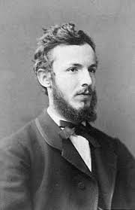
Georg Ferdinand Philip Cantor
Cantor, born in Russia in 1845, moved to Germany when he was 12 -- due to religious family background, Cantor developed an interest in theology and particularly the nature of the infinite In 1867 he completed his doctorate at the University of Berlin, he had studied with Weierstrass and developed rigor in the subject of calculus Cantor’s research into the finer points of mathematical analysis led him to consider the differences among various sets of numbers

Slide 14
Development of Set Theory
He set out to find the size of different sets, not through the means of counting, but through the means of finding a one-to-one correspondence between the two sets
Cantor defined this as such,
Two sets M and N are equivalent … if it is possible to put them, by some law, in such a relation to one another that to every element of each one of them corresponds one and only one element of the other.
In modern speak, the two sets have the same cardinality if they meet Cantor’s definition of equivalence above.
This definition is critical because it does not limit the sets to finite ones
This was uncharted territory, since dealing with the infinite was always done so under a hostile eye -- before Cantor, mathematicians dealt with the “potential infinite”
There was refusal to look at infinite sets as ever being “completed”
But not for Cantor, he was willing to view infinite sets as being a completed entity and self-contained, to be compared with other infinite sets of objects
To Cantor, it was a solid, mathematical concept worthy of examination

Slide 15
Examples
If we look at N={1,2,3,... }and E={2,4,6,...}the set of natural numbers and the set of all even integers. By Cantor’s definition it is easy to see that N and E are equivalent because we can establish a one to one correspondence between the two. We can represent each element of N by n then every element of E can be written 2n . Thus setting up a one to one correspondence.
If we use N and Z={...,-2,-1,0,1,2,...} representing all integers.
Can we manufacture a formula to create a one-to-one correspondence?

Slide 16
Denumerability
At this point, Cantor was ready to make a bold move. He said that any set that had a one-to-one correspondence with N was said to be denumerable or countably infinite He established a transfinite cardinal number to represent the number of items in a denumerable set, ℵ0 (read aleph-naught) Next let’s examine the relationship between N and Q (the set of rational numbers) Since between any two integers there are infinitely many rational numbers, then it seems that the rationals are more plentiful than the natural numbers. But Cantor showed the rational numbers are denumerable by conjuring a one-to-one correspondence between the two sets

Slide 17
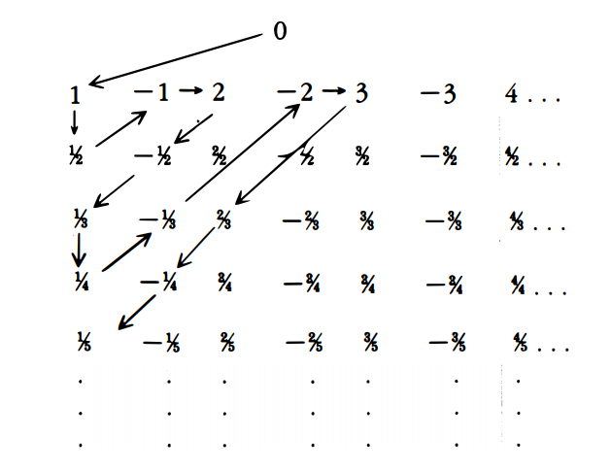
Denumerability of Q
Note: all numbers in the first column have numerator of 1, and all in the second column have numerator -1. All the numbers in the first row have denominator of 1, all in the second row have the denominator of 2. So to find the placement of a fraction such as 133/191, one must go down to the 191st row, and over to the 265th column (counting positive and negative numbers). Note: we skip over any fraction that already appeared

Slide 18
At this point, it is clear to see that the set of rationals is denumerable Which brings up the question, are all infinite sets denumerable?
If we were able to find a one-to-one correspondence from the rationals to the natural numbers it would seem so.
There was one infinite set of numbers that Cantor was able to show is non-denumerable. In his scholarly article, Uber eine Eigenschaft des Inbegriffes aller reellen algebraischen Zahlen, (translated “On the Property of the Collection of all Algebraic Numbers”) Cantor’s set he found that was non-denumerable was the collection of all real numbers. Cantor showed that no matter how small the interval of real numbers, there is no one-to-one correspondence that can be established from the natural numbers to the real numbers.

Slide 19
The Great Theorem: The non-denumerability of the continuum.
Note: “continuum” means any interval of real numbers **suggested reading: The proof of this**

Slide 20
More on Denumerability and Transcendental Numbers
Euler was the first to propose that not all numbers are well mannered and algebraic Lindemann proved that 𝜋 is a transcendental number Cantor proved the set of algebraic numbers are denumerable Cantor wanted to examine the transcendentals, he looked at an interval (a,b) , he had already proven that the algebraic numbers within this set are denumerable, and so if the transcendentals within this interval are denumerable, then the interval (being the unity of the algebraic and transcendentals) would have to be denumerable. But Cantor proved that this such interval is non-denumerable, thus forcing the transcendentals to be non-denumerable. Cantor proved that the transcendentals are non-denumerable, without producing even one example of a transcendental number!

Slide 21
In another great theorem from Chapter 12, Cantor dealt with power sets.
Given the power set of a set A, then P[A] is the set of all subsets of A.
Theorem: If A is any set, then A<P[A].

Slide 22
Thus ends our study of Cantor, all his predecessors, and the history of mathematics.

